Slide 1


Nexus
Travel Agency
CARLOS SOLARES

Slide 2
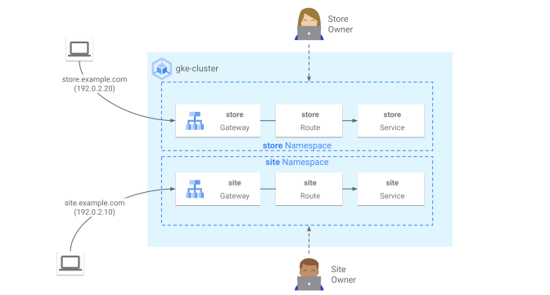
Architecture Overview
The Nexus platform is built on a robust architecture that integrates various technologies. It features a Spring Boot backend, Svelte/Vite frontend, and utilizes Oracle DB within a GKE Autopilot cluster. This structure ensures scalability, observability, and enhances overall system performance for seamless operations.

Slide 3

DevOps Pipeline Overview
Git Push
Initiates the development workflow efficiently via Git.
SonarQube
Ensures code quality through automated analysis and reviews.
Jenkins Builds
Automates deployment process, ensuring consistent releases.

Slide 4

Monitoring & Alerts Overview
Dashboards
Grafana dashboards provide real-time metrics visualization.
Monitoring
Google Cloud Monitoring ensures system health and performance.
Alerts
Automatic Slack and email alerts notify on issues.

Slide 5
95.7%
98%
Backend Test Coverage
Frontend Performance Score
This figure represents our rigorous testing efforts, ensuring that nearly all backend code is covered, enhancing reliability and reducing bugs.
Achieving an impressive frontend performance score, this metric indicates the platform's speed and responsiveness, significantly improving user experience and satisfaction.

Slide 6
Technical Debt Overview
HTTPS
Pending implementation of HTTPS will enhance security.
Automatic Rollback
Currently, there is no automatic rollback mechanism in place.
Load Tests
Manual load tests are required for performance validation and reliability.

Slide 7

RCA
ANALYSIS
01
Backend
The backend experienced pool saturation, leading to degraded performance and increased latency during peak usage times.
02
Frontend
Missing HTTPS and caching on the frontend resulted in slower page loads, affecting user experience and engagement levels.

Slide 8
81%
98%
Success Rate Pre-Fix
Target Success Rate
The backend system achieved an 81% success rate before implementing crucial fixes, indicating room for improvement in operational efficiency.
Post-fix goals aim for a 98% target success rate, reflecting our commitment to enhanced performance and overall user satisfaction in operations.

Slide 9
Remediation Roadmap
Week 1 - 2
Week 3
Week 4 - 6
Focus on enhancing security protocols and implementing HTTPS across the platform.
Optimize performance metrics by addressing latency issues and improving response times.
Ensure high-quality standards by implementing automated testing and code reviews.

Slide 10
Thank You
CONTACT US
hello@reallygreatsite.com
123-456-7890
123 Anywhere St., Any City, ST 12345

